Slide 1
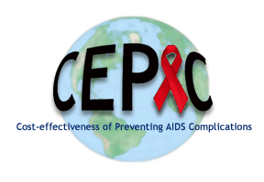
People Aging with HIV in the US:
A Simulation Modeling Approach
Emily P. Hyle, MD MSc
Division of Infectious Diseases
Massachusetts General Hospital
Associate Professor of Medicine
Harvard Medical School
Funded by: NIA R01AG069575, the Jerome and Celia Reich HIV Scholar Award, HU CFAR

Slide 2
Disclosures
Co-author at UpToDate.com

Slide 3
Outline
Background
Simulation modeling
Model projections
MSM aging with HIV
Age-associated dementia
Costs
Conclusions

Slide 4
Age distribution of PWH in the US, 2018
Total Number of PWH
Age 50-69 = 475,000
Age 70+= 44,000
4
CDC. HIV Among People Aged 50 and Older. 2014-2018.

Slide 5
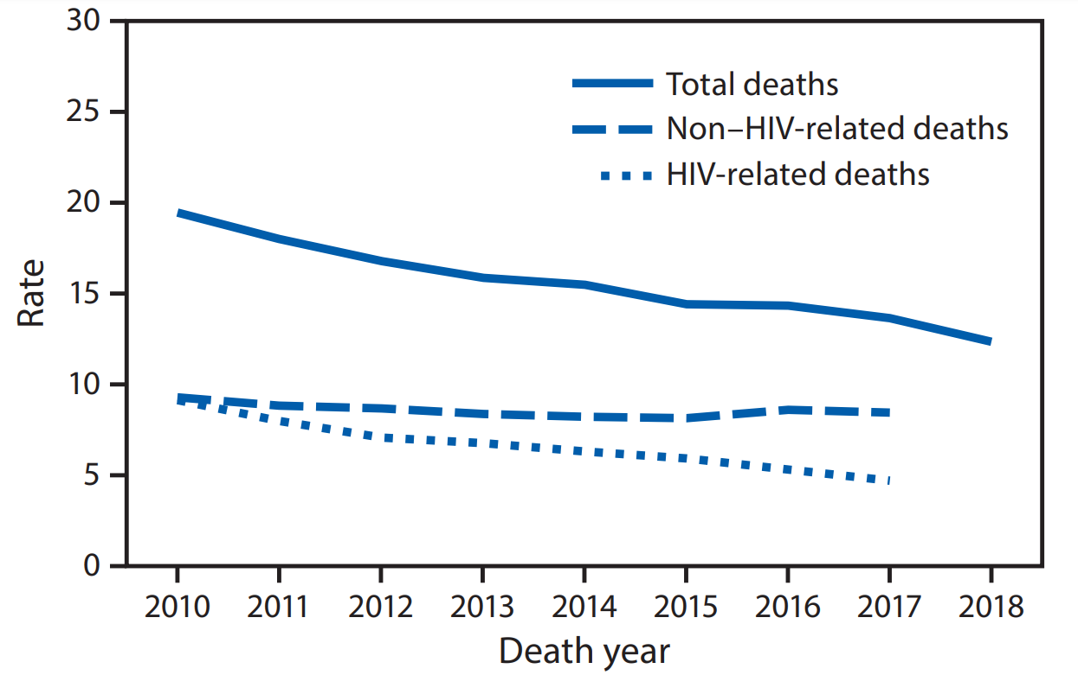
Declining HIV-related mortality, 2010-2018
5
CDC. Morbidity and Mortality Weekly Report. November 20, 2020
Notes:
Rate per 1,000 persons with diagnosed HIV

Slide 6
Multimorbidity, polypharmacy, and frailty
Multimorbidity is common and is rising among PWH
Traditional and HIV-related risk factors contribute to multimorbidity
Polypharmacy includes risks of adverse events and drug-drug interactions
Among PWH >50y, frailty is common (10.9%) and pre-frailty very common (47.2%)
Similar in frequency to community-dwelling adults >65y
Yamada et al. Open Forum Infect Dis. 2022, McNicholl et al. Pharmacotherapy 2017, Kamkwalala et al. AIDS Res Hum Retroviruses 2021,
Justice et al. Lancet Healthy Longev. 2021, Morales et al. EClinicalMedicine 2022. Althoff et al. Lancet HIV 2019
6

Slide 7
People aging with HIV in the US
Life expectancy of PWH who are engaged in care and virologically suppressed is near normal, but age-associated co-morbidities are rising
Given trends in multimorbidity, additional clinical complexity and costs are anticipated in the future
Simulation modeling can be used to project the future burden of co-morbidities among people aging with HIV
Marcus et al. JAMA Netw Open. 2020, Wong et al. CID 2017

Slide 8
People aging with HIV in the US
Life expectancy of PWH who are engaged in care and virologically suppressed is near normal, but age-associated co-morbidities are rising
Given trends in multimorbidity, additional clinical complexity and costs are anticipated in the future
Simulation modeling can be used to project the future burden of co-morbidities among people aging with HIV
Marcus et al. JAMA Netw Open. 2020, Wong et al. CID 2017

Slide 9
Outline
Background
Simulation modeling
Model projections
MSM aging with HIV
Age-associated dementia
Costs
Conclusions

Slide 10
What can we do in simulation modeling?
Use existing data to project longer-term clinical and economic outcomes
Investigate the impact of uncertainty in data on outcomes of interest
Examine which parameters have the greatest influence on outcomes
Estimate the value of specific interventions

Slide 11
“All models are wrong, but some are useful.”
– George Box

Slide 12
Cost-effectiveness of preventing AIDS complications (CEPAC) model*
CEPAC is a simulation model of HIV disease and treatment that incorporates CD4, HIV RNA, ART, opportunistic infections, and age-associated comorbidities
*Funded by NIAID, NIMH, NICHD, NIA

Slide 13
Cost-effectiveness of preventing AIDS complications (CEPAC) model*
CEPAC is a simulation model of HIV disease and treatment that incorporates CD4, HIV RNA, ART, opportunistic infections, and age-associated comorbidities
Data are from public use datasets, observational cohorts, and clinical trials
*Funded by NIAID, NIMH, NICHD, NIA

Slide 14
Cost-effectiveness of preventing AIDS complications (CEPAC) model*
CEPAC is a simulation model of HIV disease and treatment that incorporates CD4, HIV RNA, ART, opportunistic infections, and age-associated comorbidities
Data are from public use datasets, observational cohorts, and clinical trials
Model outcomes are reported in projected life expectancy, detailed clinical outcomes, and costs
*Funded by NIAID, NIMH, NICHD, NIA

Slide 15
The CEPAC microsimulation model
Acute HIV
Infection
Chronic HIV
Infection
Acute Clinical
Event
Death

Slide 16
The CEPAC microsimulation model
Acute HIV
Infection
Chronic HIV
Infection
Acute Clinical
Event
Death
Opportunistic infections
Age-associated co-morbidities

Slide 17
The CEPAC microsimulation model
Acute HIV
Infection
Chronic HIV
Infection
Acute Clinical
Event
Death
Age
Sex at birth
CD4+
HIV RNA

Slide 18
The CEPAC microsimulation model
Acute HIV
Infection
Chronic HIV
Infection
Acute Clinical
Event
Death

Slide 19
The CEPAC microsimulation model
Acute HIV
Infection
Chronic HIV
Infection
Acute Clinical
Event
Death

Slide 20
The CEPAC microsimulation model
Acute HIV
Infection
Chronic HIV
Infection
Acute Clinical
Event
Death

Slide 21
The CEPAC microsimulation model
Acute HIV
Infection
Chronic HIV
Infection
Acute Clinical
Event
Death

Slide 22
CEPAC model outcomes
Acute HIV
Infection
Chronic HIV
Infection
Acute Clinical
Event
Death
Clinical events
Life years
Transmissions
Costs

Slide 23
Outline
Background
Simulation modeling
Model projections
MSM aging with HIV
Age-associated dementia
Costs
Conclusions

Slide 24
MSM aging with HIV in the US
To project the burden of age-associated comorbidities among people with HIV in the US, we first examined the face validity of model-projected numbers and age distribution of people aging with HIV
We focused initially on MSM with HIV as the largest group of people with HIV engaged in care in the US

Slide 25
Objective
To use CEPAC to project the numbers and age distribution of MSM on ART from 2021 to 2031

Slide 26
Simulating the HIV care continuum
PWH who have
been diagnosed
Incident
Undiagnosed
On ART
Out of Care
Prevalent
Hyle and Kasaie et al. JID. 2023

Slide 27
Progression along the HIV care continuum
PWH who have
been diagnosed
Incident
Undiagnosed
All PWH
On ART
Out of Care
Hyle and Kasaie et al. JID. 2023

Slide 28
Cohort characteristics at model start
Cohort | Initial CD4 count, mean cells/μl (SD) | Initial age, mean years (SD) | Cohort size, n
Incident | 667 (134) | 33.7 (10.7) | Determined by transmissions
Hyle et al. CROI 2021, Althoff et al., JIAS 2016; Buchacz et al., Open AIDS J 2015; Lundgren et al., N Engl J Med 2015
CDC HIV Surveillance Report Vol. 31; CDC HIV Surveillance Supplemental Report Vol. 25 No. 1

Slide 29
Cohort characteristics at model start
Cohort | Initial CD4 count, mean cells/μl (SD) | Initial age, mean years (SD) | Cohort size, n
Incident | 667 (134) | 33.7 (10.7) | Determined by transmissions
Undiagnosed | 436 (166) | 34.6 (11.2) | 109,700
Hyle et al. CROI 2021, Althoff et al., JIAS 2016; Buchacz et al., Open AIDS J 2015; Lundgren et al., N Engl J Med 2015
CDC HIV Surveillance Report Vol. 31; CDC HIV Surveillance Supplemental Report Vol. 25 No. 1

Slide 30
Cohort characteristics at model start
Cohort | Initial CD4 count, mean cells/μl (SD) | Initial age, mean years (SD) | Cohort size, n
Incident | 667 (134) | 33.7 (10.7) | Determined by transmissions
Undiagnosed | 436 (166) | 34.6 (11.2) | 109,700
On ART (in care) | 600 (313) | 45.7 (11.7) | 370,000
Althoff et al., JIAS 2016; Buchacz et al., Open AIDS J 2015; Lundgren et al., N Engl J Med 2015
CDC HIV Surveillance Report Vol. 31; CDC HIV Surveillance Supplemental Report Vol. 25 No. 1

Slide 31
Cohort characteristics at model start
Cohort | Initial CD4 count, mean cells/μl (SD) | Initial age, mean years (SD) | Cohort size, n
Incident | 667 (134) | 33.7 (10.7) | Determined by transmissions
Undiagnosed | 436 (166) | 34.6 (11.2) | 109,700
On ART (in care) | 600 (313) | 45.7 (11.7) | 370,000
Off ART (out of care) | 325 (53) | 45.7 (11.8) | 124,000
Althoff et al., JIAS 2016; Buchacz et al., Open AIDS J 2015; Lundgren et al., N Engl J Med 2015
CDC HIV Surveillance Report Vol. 31; CDC HIV Surveillance Supplemental Report Vol. 25 No. 1

Slide 32
PWH Out of Care
Return to Care
Diagnosis & Linkage
PWH In Care and On ART
Death
Lost to Follow Up

Slide 33
PWH Out of Care
PWH Out of Care
Return to Care
Return to Care
Diagnosis & Linkage
Diagnosis & Linkage
PWH In Care and On ART
PWH In Care and On ART
Death
Death
Lost to Follow Up
Lost to Follow Up

Slide 34
CEPAC-US: Projected numbers of MSM on ART
Hyle and Kasaie et al. JID. 2023

Slide 35
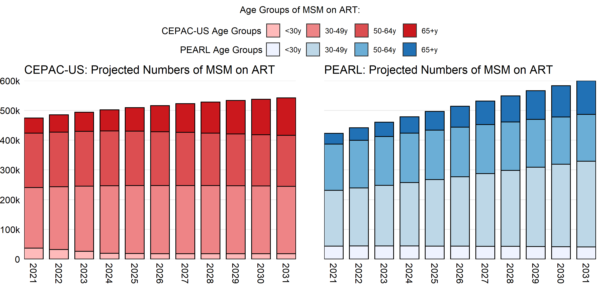
Results: CEPAC-PEARL Collaboration
Hyle and Kasaie et al. JID. 2023
*PEARL is led by Drs. Keri Althoff and Parastu Kasaie (R01AG053100)

Slide 36
Outline
Background
Simulation modeling
Model projections
MSM aging with HIV
Age-associated dementia
Costs
Conclusions

Slide 37
PWH and Dementia
HAND
Alzheimer’s
VCID
Rubin et al. Curr Top Behav Neurosci. 2021, Aung et al. Eur Geriatr Med. 2019, Zlokovic et al. Alzheimers Dement. 2020, Rubin et al. J Neurovirol. 2019

Slide 38
PWH and Dementia
HAND
Alzheimer’s
VCID
We focused on the anticipated burden of age-associated dementias among people aging with HIV in the US
Rubin et al. Curr Top Behav Neurosci. 2021, Aung et al. Eur Geriatr Med. 2019, Zlokovic et al. Alzheimers Dement. 2020, Rubin et al. J Neurovirol. 2019

Slide 39
Objective
To compare the cumulative incidence of age-associated dementias (AAD) among 2 populations:
General US population
People with diagnosed HIV (PWDH)
Hyle et al. Manuscript under review.

Slide 40
Model input parameters
People aged 60y without AAD at model start
Developed age- and sex-stratified AAD incidence and mortality rates from general population in the US and applied 1.8x for PWH
Incorporated increased risk of age-/sex-stratified non-HIV-related mortality for PWH
Hyle et al. Manuscript under review.

Slide 41
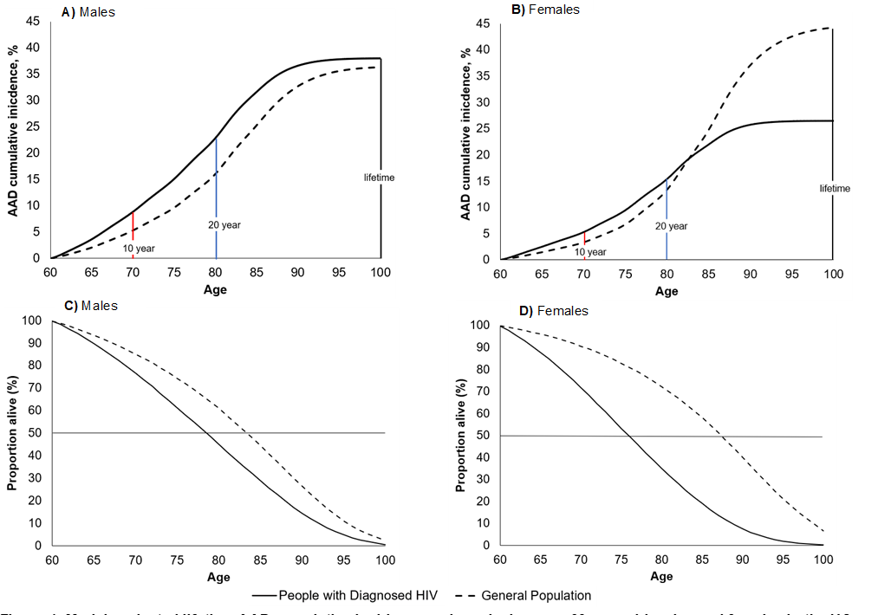

Slide 42
Sensitivity analyses
HIV-focused parameters
No loss to follow-up (LTFU)
AAD-focused parameters
AAD incidence among PWH
Premature aging
2x AAD incidence
Mortality shifted 5y earlier
Non-HIV mortality rate shifted 5y earlier
Hyle et al. Manuscript under review.

Slide 43
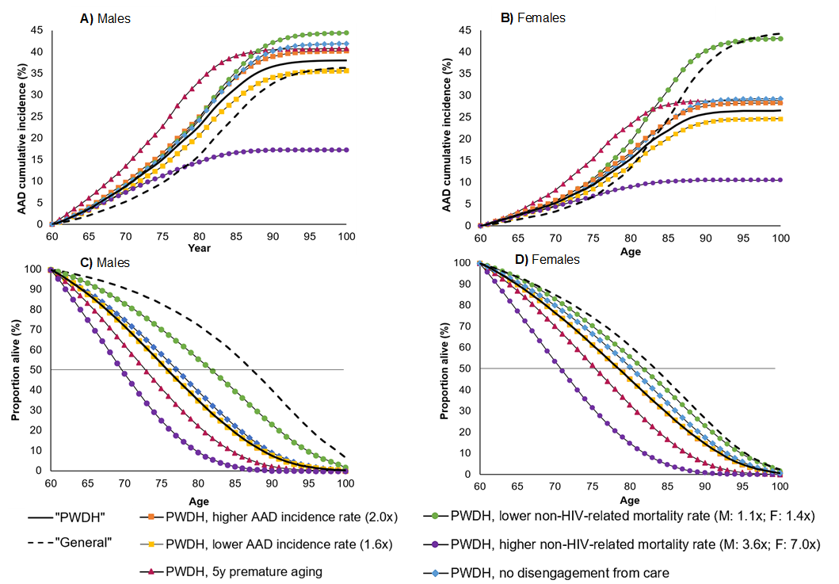
Hyle et al. Manuscript under review.

Slide 44
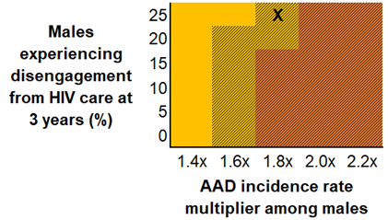
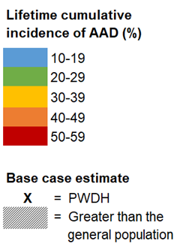
CEPAC-projected AAD outcomes:
Two-way sensitivity analysis (males)
Disengagement in HIV care at 3 years and AAD incidence rates
Hyle et al. Manuscript under review.

Slide 45
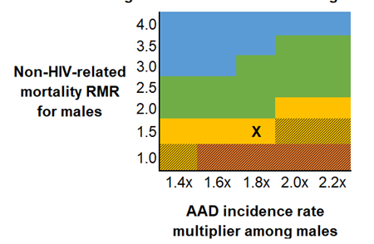
CEPAC-projected AAD outcomes:
Two-way sensitivity analysis (males)
Non-HIV-related mortality RMR and AAD incidence rates
Hyle et al. Manuscript under review.

Slide 46
Future work
To examine the future impact of co-morbidities among people with HIV, including costs, to anticipate future health systems needs
Integrating CVD and Depression into the model with Dementia and HIV
To investigate the clinical implications and cost-effectiveness of different interventions to prevent or treat age-associated co-morbidities

Slide 47
Outline
Background
Simulation modeling
Model projections
MSM aging with HIV
Age-associated dementia
Costs
Conclusions

Slide 48
ART costs in the US
Among all well-resourced countries, the US has the highest ART costs and the lowest rate of HIV viral suppression
$3-4,000 out-of-pocket per year
Only 66% virally suppressed
McCann JAMA Intern Med. 2020, Tseng JAMA Netw Open. 2020, CDC HIV Surveillance Supplemental Report 2021

Slide 49
DHHS ART guidelines
Recommended Initial Regimens for Most People with HIV
Have demonstrated durable virologic efficacy Favorable tolerability and toxicity profiles Ease of use
Recommended Initial Regimens in Certain Clinical Situations
Effective and tolerable, but have some disadvantages or have less supporting data from randomized clinical trials In certain clinical situations, one of these regimens may be preferred
https://clinicalinfo.hiv.gov

Slide 50
Rising ART costs in the US
To characterize changes in initial ART regimen costs over time, focusing on recommended regimens for:
Most people with HIV
Certain clinical situations
Obtained the annual, average wholesale price of ART regimens recommended by the DHHS guidelines (2012-18)
McCann JAMA Intern Med. 2020

Slide 51
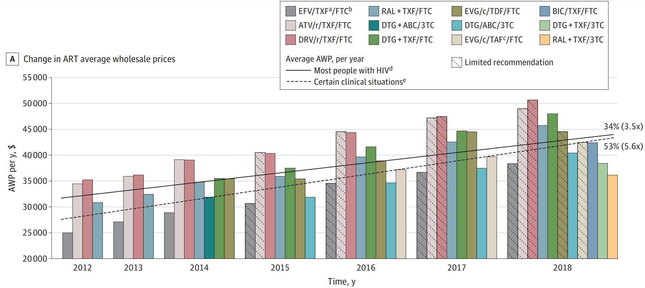
Annual ART average wholesale prices (AWP)
34% (3.5x)
McCann et al. JAMA Intern Med. 2020

Slide 52
Annual ART average wholesale prices (AWP)
34%
53%
McCann JAMA Intern Med. 2020

Slide 53
Annual ART average wholesale prices (AWP)
34%
53%
CPI: 9%
McCann JAMA Intern Med. 2020

Slide 54
Who pays for ART among aging PWH?

Slide 55
Medicare Part D
Approximately 25% of PWH in clinical care are enrolled in Medicare
Most are also enrolled in Medicare Part D for prescriptions
Complicated cost-sharing structure in Medicare Part D obscures who bears the burden of high ART costs
Tseng JAMA Netw Open. 2020

Slide 56
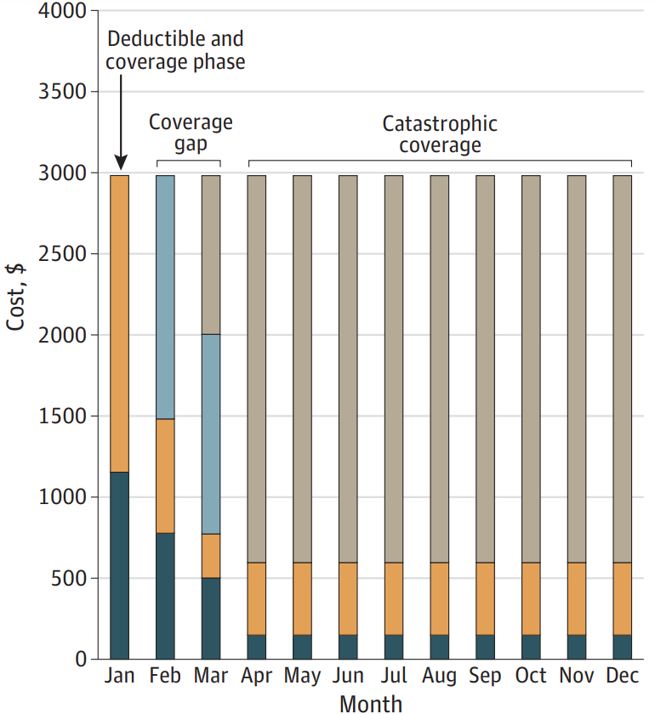
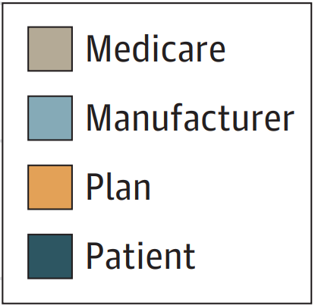
Part D cost-sharing between patients, insurance plans, manufacturers, and Medicare for ART
Tseng JAMA Netw Open. 2020

Slide 57
Inequities in Medicare Part D cost-sharing
With standard coverage, annual out-of-pocket costs are substantial ($3,300-$4,400/year)
Tseng JAMA Netw Open. 2020

Slide 58
Inequities in Medicare Part D cost-sharing
With standard coverage, annual out-of-pocket costs are substantial ($3,300-$4,400/year)
Low-income subsidies (LIS) are available but vary depending on person’s income
Tseng JAMA Netw Open. 2020

Slide 59
Inequities in Medicare Part D cost-sharing
With standard coverage, annual out-of-pocket costs are substantial ($3,300-$4,400/year)
Low-income subsidies (LIS) are available but vary depending on person’s income
Higher ART prices result in greater costs assumed by Medicare beneficiaries and government payers
Tseng JAMA Netw Open. 2020

Slide 60
Anticipated growth in Medicare beneficiaries with HIV by 2033
Almost 500,000 Medicare beneficiaries by 2033
CDC. HIV Among People Aged 50 and Older. 2014-2018.
60

Slide 61
Association of HIV with health care spending among Medicare beneficiaries
Utilizing 2016 Medicare claims data (20% sample), we compared Medicare spending among:
People without HIV (n=4.5 million)
People with HIV (n=21,564)
Figueroa et al Health Affairs, 2022

Slide 62
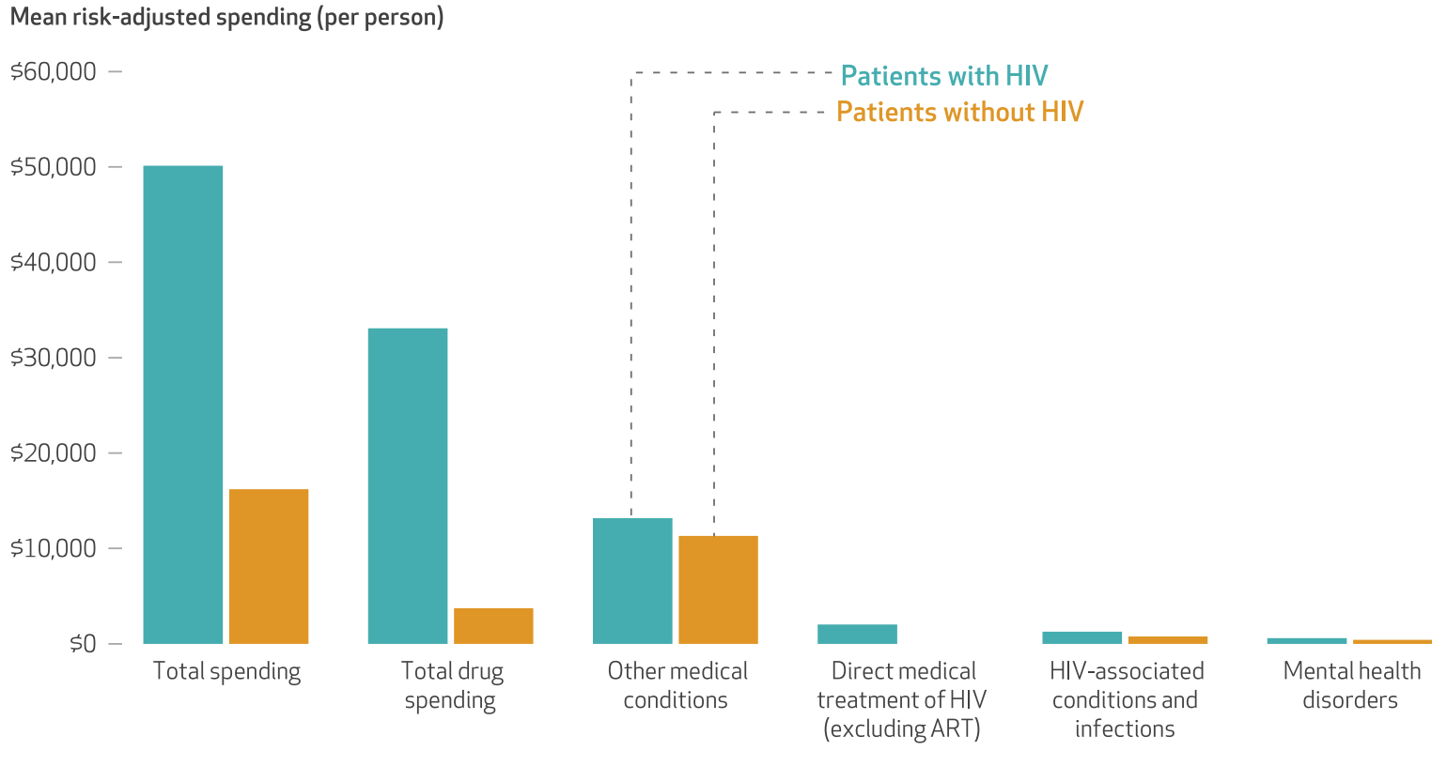
Overall 2016 Medicare spending for people with and without HIV
People with HIV
People without HIV
Figueroa et al Health Affairs, 2022

Slide 63
Overall Medicare spending for people with and without HIV
People with HIV
People without HIV
∆ 209%
∆ 785%
∆17%
∆ 66%
∆ 44%
Figueroa et al Health Affairs, 2022

Slide 64
Not all Medicare beneficiaries with diagnosed HIV are prescribed ART in 2016
Figueroa et al Health Affairs, 2022
Notes:
MJS: could this be a figure?

Slide 65
More comorbidities among Medicare beneficiaries not prescribed ART
Figueroa et al Health Affairs, 2022

Slide 66
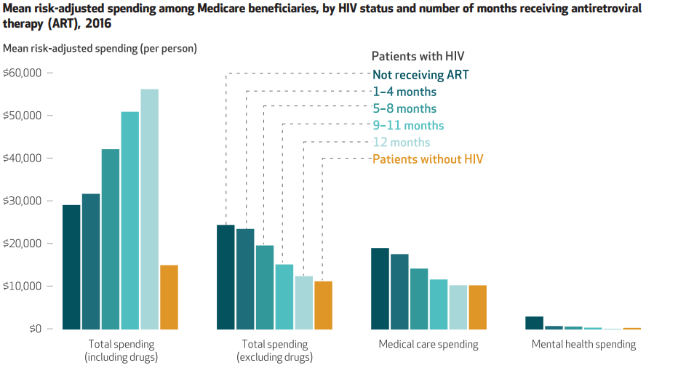
Medicare spending by HIV status and months since ART initiation
People prescribed ART had less Medicare spending on mental health and other medical comorbidities
Figueroa et al Health Affairs, 2022

Slide 67
Next Steps
Assessing multi-year Medicare claims data for trends in ART use and risk factors for no ART use
Considering trends in Medicare Advantage for people aging with HIV
Parameterizing CEPAC with cost data from Medicare

Slide 68
Conclusions
People aging with HIV will grow in number given the effectiveness of ART
Multimorbidity is a major issue and will increase as people age
Screening and treatment strategies are essential
Costs will grow with a direct impact on PWH due to out-of-pocket costs, as well as on taxpayers
Simulation modeling is a method to examine and investigate interventions that are clinically effective and cost-effective

Slide 69
US CEPAC Team
Luke Ang, BS
Ingrid Bassett, MD, MPH
Wanyi Chen, PhD
Kevin Chi, BS
Andrea Ciaranello, MD, MPH
Julie Deleger, BA
Lotanna Dike, MPH
Caitlin Dugdale, MD
Florence Ebem, BA
Mary Feser, BA
Clare Flanaghan, MPH
Kenneth Freedberg, MD, MSc
John Giardina, PhD
Emily Hyle, MD, MSc
Michelle Jones, BS
Elena Losina, PhD
Munashe Machoko, BA
Amir Mohareb, MD
Nora Mulroy, BA
Anne Neilan, MD, MPH
A. David Paltiel, PhD
Pamela Pei, PhD
Krishna Reddy, MD, MSc
Katherine Rich, MPH
Paul Sax, MD
Justine Scott, MPH
Prakriti Shrestha, BA
Hailey Spaeth, BA
Acadia Thielking, BA
Nattanicha Wattananimitgul, BA
Milton Weinstein, PhD
Funded by: CHARMED (R01AG069575), Jerome and Celia Reich HIV Scholar Award, Optimizing HIV Care in Less Developed Countries (R37AI058736), Cost-effectiveness of Preventing HIV Complications (R01AI042006), Innovation Across the Spectrum of Pediatric HIV Care (R01HD079214), and Novel Methods to Inform HIV/TB Clinical Trial Development (R01AI093269)

Slide 70
Thank you
Contact information: Emily Hyle
Email: ehyle@mgh.harvard.edu
Twitter: @EmilyHyle
Funding sources: The Jerome and Celia Reich HIV Scholar Award and R01 AG069575

Slide 71
Additional slides

Slide 72
Increasing multimorbidity among PWH in care
72
Wong et al. CID 2017

Slide 73
“Traditional” risk factors are important
Compared with HIV-related risk factors for non-communicable diseases, traditional risk factors contribute markedly to risk:
smoking, dyslipidemia, hypertension, and chronic hepatitis C infection
A substantial proportion of these comorbidities could be prevented with increased targeted interventions and screening
Althoff et al. Lancet HIV 2019

Slide 74
“Traditional” risk factors are important
Althoff et al. Lancet HIV 2019

Slide 75
CEPAC-US: Age distribution among MSM on ART
Hyle et al. CROI 2021

Slide 76
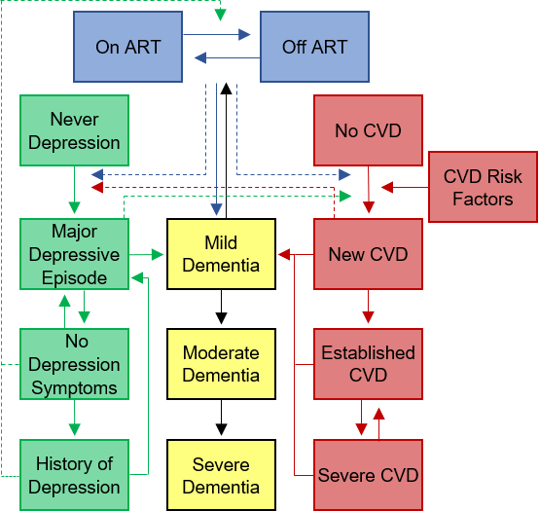

Slide 77
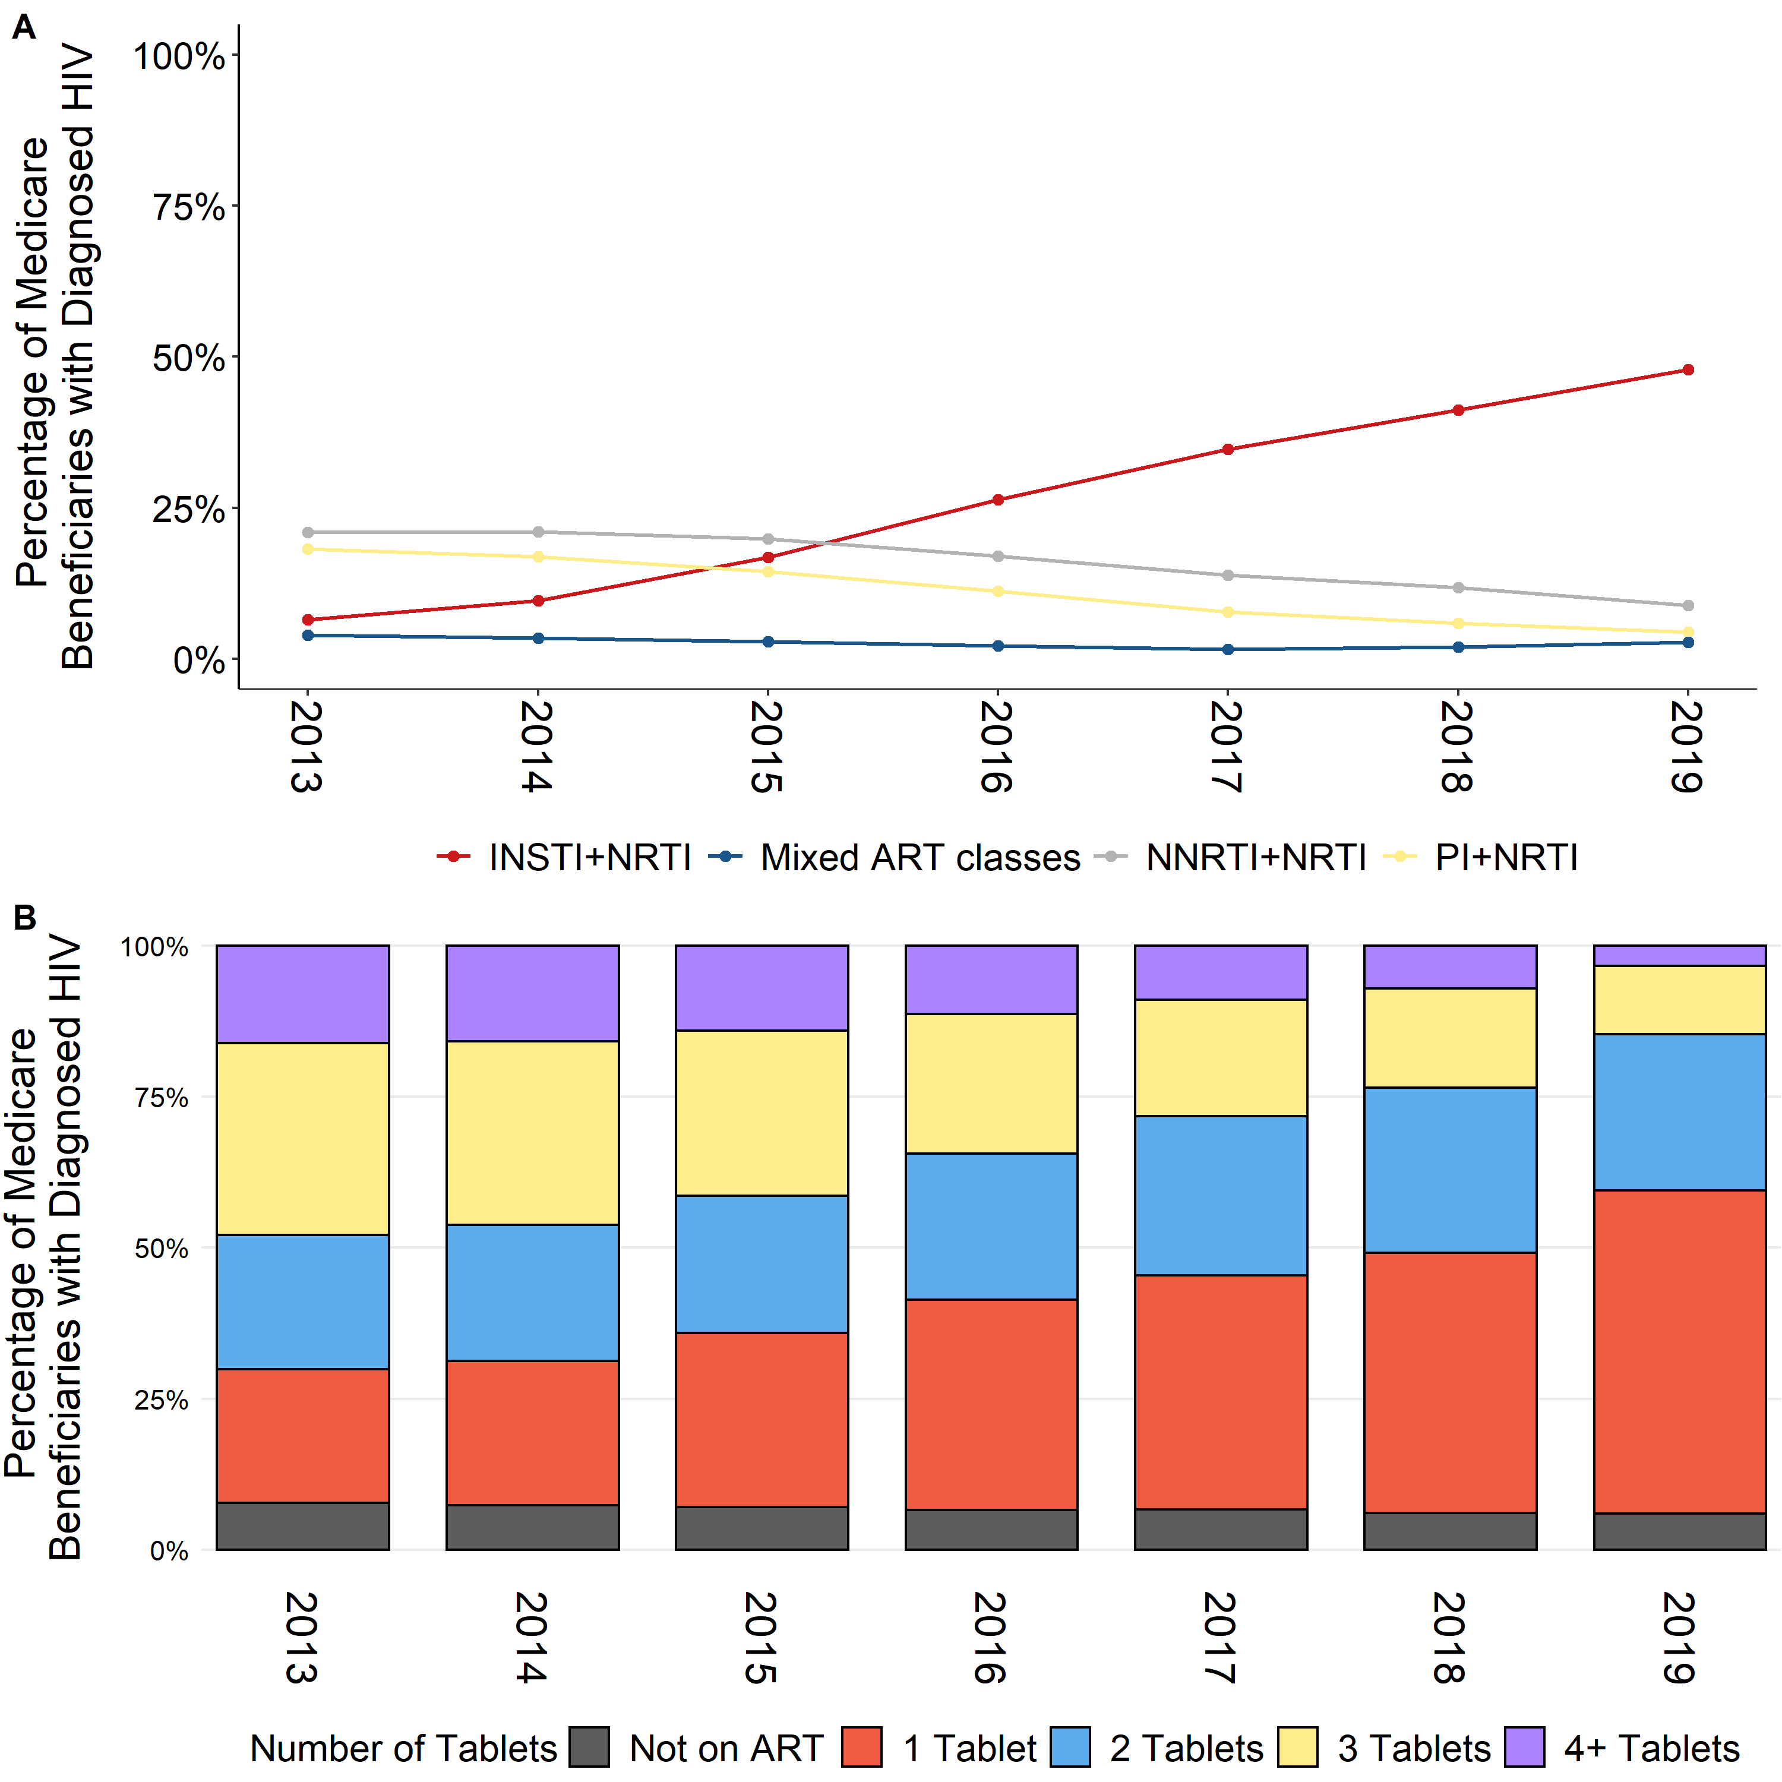
Increasing Percentage of INSTI Use
Figueroa at al CROI 2022

Slide 78
Fewer Multi-Pill Regimens Prescribed
Figueroa at al CROI 2022

